Slide 1
Tutorial 2 Fall 2020
SOFE 3200U: Systems Programming
Abdelrahman Elewah

Slide 2
In the previous tutorial, we have this unanswered question that related to top command

Slide 3
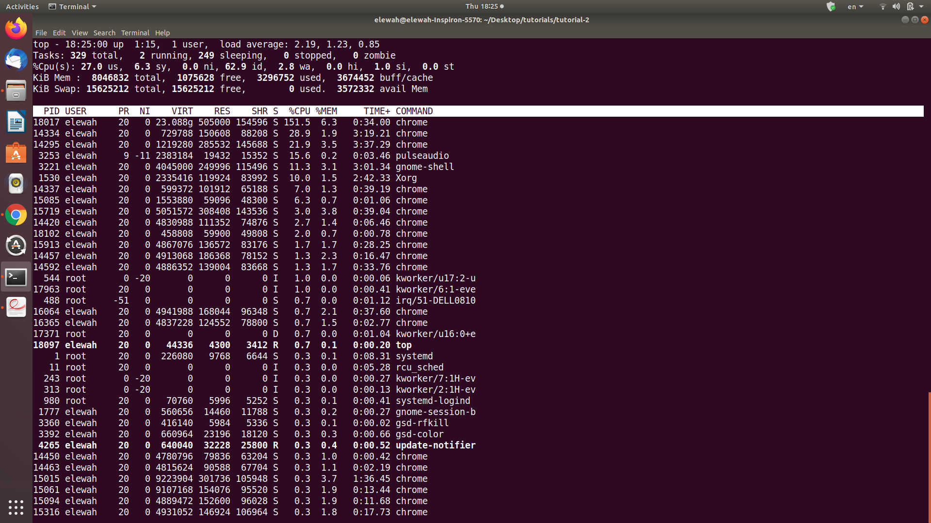

Slide 4
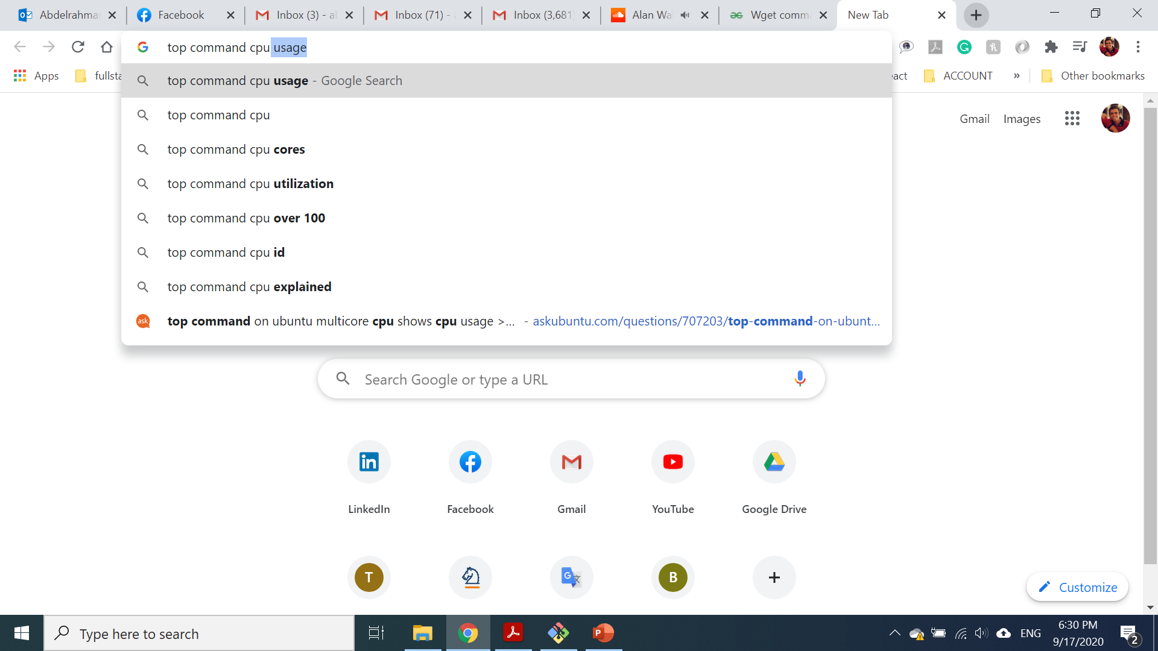
Top command

Slide 5

Top command

Slide 6
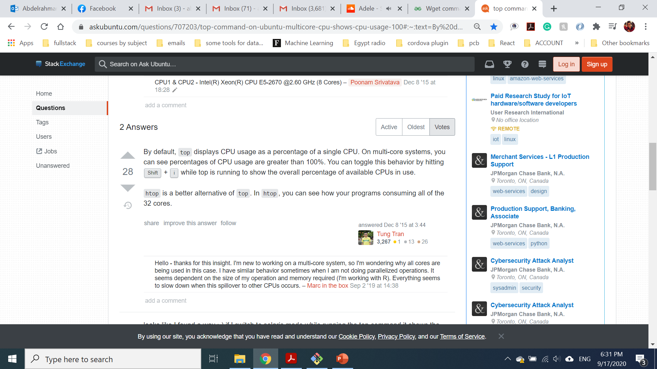

Slide 7
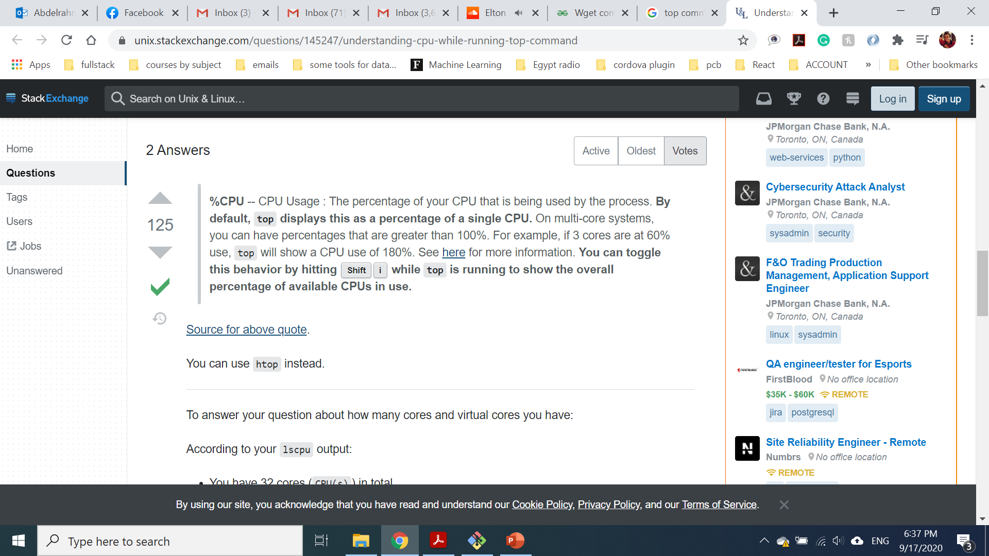

Slide 8
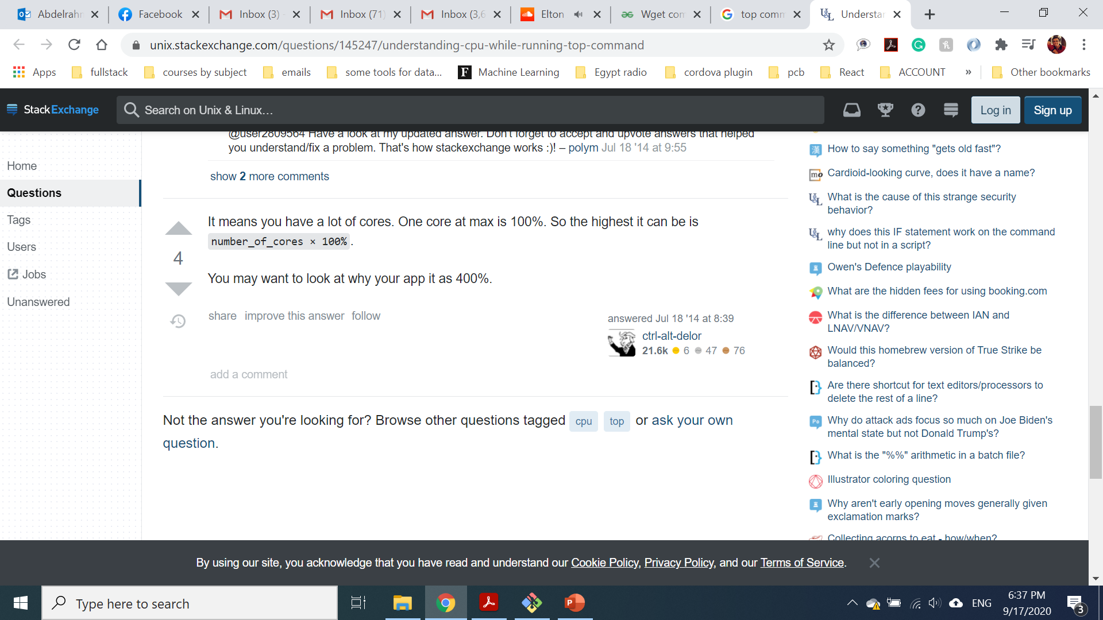

Slide 9
Agenda
Downloading This Tutorial Using wget Command
Shell Plumbing
Pipes
Redirects
Basic Commands
Quiz

Slide 10
Downloading This Tutorial Using wget Command

Slide 11
Downloading This Tutorial using wget Command
wget command : wget http://ericdube.com/sofe3200/2/INDEX.md
Github is software development and version control
Markdown language
Good online course to learn Git and GitHub :
-https://www.udacity.com/course/version-control-with-git--ud123
-https://www.udacity.com/course/version-control-with-git--ud456
wget https://github.com/elewah/elewah.github.io/blob/master/courses/system%20programming/Tutorial2.pdf

Slide 12
Shell Plumbing

Slide 13

Shell Plumbing
A shell is a CLI (Command-Line Interface)
Streams
When you run any program in the shell, it will have access to three streams: -
One input stream:stdin (standard in)
Two output streams: stdout and stderr (standard out and standard error)
stdin
stdout
stderr

Slide 14
Shell Plumbing
Why two output streams?
It is important to distinguish between valid output of a command and output due to errors. Like a function, you can make some assumptions about the output of a command. If errors were mixed in with the output, you wouldn't be able to make these assumptions.
For example, the ls command will always write a list of files (or nothing) to stdout. Any error message is sent over stderr.
For instance try this command
ls /root /var (stdout)
stdin
stdout
stderr

Slide 15
Pipes

Slide 16
Pipes
Pipes are a very powerful tool which allow you to create your own data flow in the terminal. A pipe connects two streams together.
The piped commands run concurrently. This can be very helpful for basic multiprocessing.
For example, running the following will display all files in the working directory which contain the letter "a".
ls | grep "a"

Slide 17
Redirects

Slide 18
Redirects
The output of a command can also be directed to a file (or stream) using redirection.
Using < will redirect a file's contents to stdin
while using > will redirect stdout and write it to a file.
echo "Hello, world!" > helloworld.txt
printf "This is cool! \n This is awesome!" > myfile.txt
grep "a" < myfile.txt

Slide 19
Basic Commands

Slide 20
Basic Commands
man
man will display usage instructions for a command. For example man man displays the usage of man.
pwd and ls
pwd stands for Print Working Directory. It displays the current working directory. This command
normally doesn't take any parameters.
ls [OPTION]... {FILE]... lists the contents of the working directory, or a directory passed as an
argument. This command also has flags to change the behaviour, which you can see by running ls
--help or man ls.
date
date is a command which can print the date and time. A format can be passed preceded by a plus
symbol. For example, date +%I:%M:%S\ %p displays the time in this format: 9:00:00 PM

Slide 21
Basic Commands
cat
cat is a command intended for concatenating files, but there are many useful applications of cat.
This command can take input from multiple files and the input stream, and will write all of these to
the output stream.
examples:
l cat file1.txt file2.txt - Display the contents of two files
l cat file1.txt file2.txt > file1and2.txt - Concatenate files
l echo "hello" | cat file1.txt - - Append "hello" to a file
more
more is a useful command to display an input one screen at a time. For example: ls -R / | more
displays all files, one screen at a time.

Slide 22
Basic Commands
head and tail
head and tail display the first lines and last lines of a file respectively. By default, they display the
last 10 lines, but passing the -n flag (ex: head -n 5) can override this behaviour. tail also has a flag
-f to follow the end of a file. In this mode, tail will stay open and display every new line added to a
file
mkdir, rmdir, cd
mkdir and rmdir provide creation and deletion of directories respectively. Note that rmdir requires
the directory to be empty for removal.
cd [PATH] changes the current directory. With no parameters, cd will set the working directory to
the user's home directory.
mv, cp
mv is the rename command. It takes two arguments: source and destination.

Slide 23
Basic Commands
wc
wc is a useful command for counting words, lines, or characters. It can receive input from stdin, or a
filename as an argument. There are three flags available: l, w, and c; for lines, words, and
characters respectively. For example, to display the number of lines and words in some input text,
try printf "Hello\nThis is text" | wc.
Note: Even if the flags are passed in a different order, wc will always display lines, words, then
characters.
sort
sort will sort input from stdin, or from a filename accepted as a paramters.

Slide 24
Basic Commands
chown, chgrp, chmod
chown [USER] FILE changes the owner of a specified file. With only the file as a parameter, chown
by default changes the user to the current user.
chgrp GROUP FILE changes the group of the specified file.
chmod MODE FILE changes the permissions of the specified file to the specified mode.
examples:
l chown FILE.txt - Change ownership of FILE.txt to current user
l chgrp www-data /var/www/html - Change group of /var/www/html to the www-data group
l chmod 640 file.doc - Change permissions of file.doc so owner has read and write access, group
has read access, and other users have no access.

Slide 25
Basic Commands
Permissions
drwxrwxrwx
Permissions are represented as a bitmask containing 9 bit values. - The first three bits represent
the owner's permissions. - The second three bits represent the group's permissions. - The last three
bits represent the permissions of other users.
Each three bits are usually represented as rwx. For example, r-x represents read and execute
permissions, without write permissions.
When you pass the -a flag to ls you will see the a line representing the file permissions. It will also
contain a d character at the beginning of the item is a directory (or a dash otherwise).

Slide 26
Quiz

